Slide 1
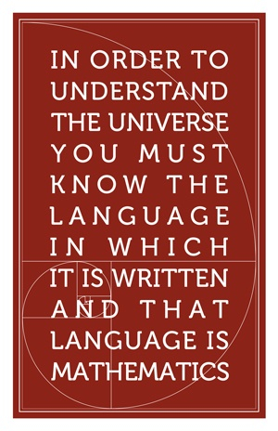
- GALILEO GALILEI

Slide 2
MATHEMATICS BREAKS THE WORLD DOWN INTO NUMBERS AND SYMBOLS

Slide 3
BE PREPARED: MATHEMATICS & STATISTICS ARE POWERFUL TOOLS FOR LIFE
MATHEMATICS
STATISTICS
Make connections between different areas of knowledge
Create or add value
Compete on a global scale
SURVIVAL IN THE WILDERNESS
SURVIVE & THRIVE IN THE REAL WORLD

Slide 4
LUCRATIVE PROFESSIONS REQUIRE A SOUND UNDERSTANDING OF MATHEMATICS & STATISTICS

Slide 5

BIG DATA IS EVERYWHERE
BUT WHAT DOES IT ALL MEAN?

Slide 6

“I keep saying the sexy job in the next ten years will be STATISTICIANS….The ability to take data—to be able to understand it, to process it, to extract value from it, to visualize it, to communicate it—that’s going to be a hugely important skill in the next decades…” - Hal Varian
Chief Economist, GOOGLE

Slide 7



OUR GRADUATES. WHERE ARE THEY NOW?
James Bonifacio
Catherine
Andrew Richen Cumpstone
Statistical Analysts STATISTICS NEW ZEALAND
D. Phil Candidate OXFORD UNIVERSITY, UK
MATHEMATICS & STATISTICS
Katy Bergstrom
James Williams
Ph.D. Candidate
YALE UNIVERSITY, USA
Economic Analyst
RESERVE BANK OF NEW ZEALAND

Slide 8
THE CAREER POSSIBILITIES ARE ENDLESS
INDUSTRY & COMMERCE
ORION - Network Investment Analyst A university degree that includes economics, mathematics and physics
Meteorological Service, NZ – Trainee
Pacific Edge Biotech, Ltd – Informatician
Rodgers & Partners Consultants Ltd –
Business Analyst
Tower Managed Funds Ltd – Actuary
Weyerhaeuser Ltd – Logistics Coordinator
Zespri Int Ltd – Innovation Analyst
GOVERNMENT
ACC – Analysts
Defence Technology Agency – Scientist/Analyst
Government Communications Security Bureau – Communications System Analyst, Mathematician
Land Transport Safety Authority of New Zealand – Economics Analyst
Ministry of Education – Research Analyst
Ministry of Fisheries – Regional Intelligence Analyst
Ministry of Health – Intelligence Analyst
Ministry of Social Development – Analysts – Forecasting & Modeling Unit
New Zealand Treasury – Analyst/Senior Analyst – Macro Forecasting and Analysis
….and many more!
STATISTICS NEW ZEALAND
Analyst - Regional & Housing
Analysts – National & Enterprise Accts
Analysts - Payments, Trade
Economic Statistician
Mathematical Statisticians
Analyst - Maori Statistics Unit
Economic Statistician/Analyst

