Slide 1
UC More, Feel More, Do More: Augmenting Engineering Mathematics Lectures and Tutorials with Visual, Tactile and Kinaesthetic Learning Aids
Raazesh Sainudiin

Slide 2

- GALILEO GALILEI

Slide 3
GOAL IN THE CLASSROOM
We need our students to
UNDERSTAND CONCEPTS CLEARLY,
Not just follow formulaic recipes

Slide 4
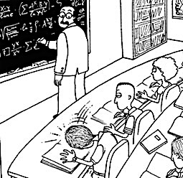




REALITY IN THE CLASSROOM
www.chronicleoftheoldwest.com
http:www.chemistryland.com
www.acclaimimages.com
www.bobgriggs.com

Slide 5
THE PROBLEM
We have a limited time
to cover a comprehensive syllabus
to a large number of students
Mathematics is a difficult language!
WE NEED TO COMMUNICATE BEYOND TRADITIONAL READ/WRITE METHODS
BY USING MORE
VISUAL, TACTILE & KINAESTHETIC STRATEGIES

Slide 6
Example: Hyperbolic Paraboloid
Traditional Read/Write: Formula
Visual: Image

Slide 7
THE SOLUTION –
GOING A STEP FURTHER
What if students could:
    SEE More
    FEEL More
    DO More
with the aid of Custom 3D-printed learning aids?

Slide 8
WHAT IS 3D PRINTING?
www.ebay.com
3D printers make manufacturing digital, personal and affordable

Slide 9
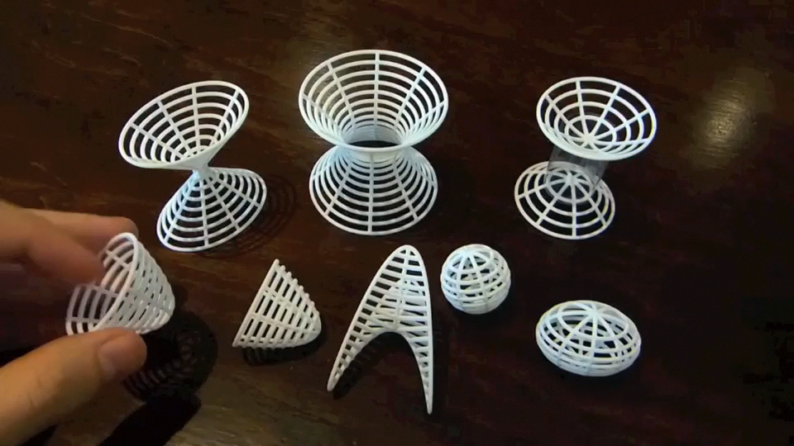
EXAMPLES OF CALCULUS SURFACES
3D-PRINTED LEARNING AIDS
Credit: Henry Segerman
youtube.com/watch?v=10KjAi5eA1Q

Slide 10
HOW TO PRINT CUSTOM 3D OBJECTS FOR TUTORIAL PROBLEMS: JUST 3 STEPS
MATHEMATICAL CONCEPT → COMPUTER MODEL → 3D PRINTED AID

Slide 11
HOW TO PRINT CUSTOM 3D OBJECTS FOR TUTORIAL PROBLEMS: JUST 3 STEPS
MATHEMATICAL CONCEPT → COMPUTER MODEL → 3D PRINTED AID
12 lines of MATHEMATICA Code
STL file for printing

Slide 12
HOW TO PRINT CUSTOM 3D OBJECTS FOR TUTORIAL PROBLEMS: JUST 3 STEPS
MATHEMATICAL CONCEPT → COMPUTER MODEL → 3D PRINTED AID

Slide 13
3D-PRINTED LEARNING AIDS
Scaling to suit classroom and tutorial style learning
Credit: Henry Segerman
youtube.com/watch?v=LBiiOEiD3Yk

Slide 14
MORE EMTH CONCEPTS THAT CAN BE AUGMENTED WITH LEARNING AIDS
2D & 3D Integration
Volumes of Rotation
Line & Contour Integrals
Polar & Spherical Coordinates
Transformation of random vectors
Tangent Planes
Linear Independence

Slide 15
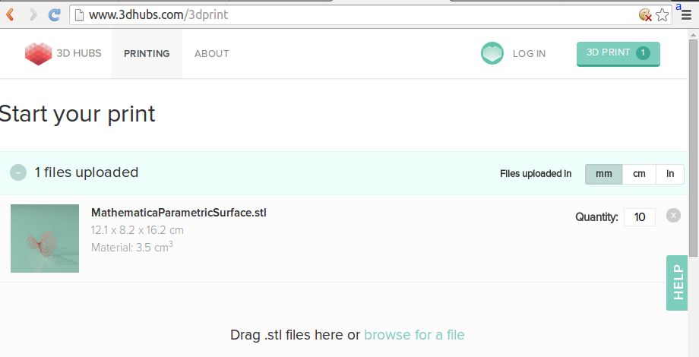
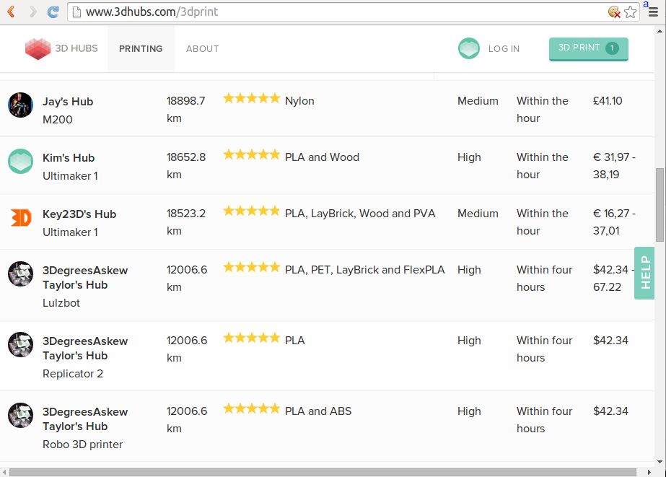
FEASIBILITY
Use online services
Average Tutorial:
6 Problems
3 Parallel Sessions
Will need 18 Objects
Cost for this example 72 USD

Slide 16
FEASIBILITY
Buy a designated printer for the school
    Cost effective in the long run
    More applications for
        Honours courses
        Marketing/Outreach

Slide 17
MEASURING EFFICACY
Solicit Direct Feedback from
    Students on their learning experience in the Course Survey
    Tutors on Student Engagement
Compare student performance in examinations with historical records (SDB)

Slide 18
CONCLUSION
For conceptual clarity, there’s nothing better than being able to see, feel and manipulate a mathematical object with one’s bare hands!

Slide 19
REFERENCES
SEGERMAN H (2012) 3D Printing for Mathematical Visualisation.
KNILL O and SLAVKOVSKY E (2013) Illustrating Mathematics Using 3D Printers.
Thank you

